Slide 1
Algorithms and Data Structures
Lecture VII
Simonas Šaltenis
Nykredit Center for Database Research
Aalborg University
simas@cs.auc.dk

Slide 2
This Lecture
Binary Search Trees
  Tree traversals
  Searching
  Insertion
  Deletion

Slide 3
Dictionaries
Dictionary ADT – a dynamic set with methods:
  Search(S, k) – a query method that returns a pointer x to an element where x.key = k
  Insert(S, x) – a modifier method that adds the element pointed to by x to S
  Delete(S, x) – a modifier method that removes the element pointed to by x from S
An element has a key part and a satellite data part

Slide 4
Ordered Dictionaries
In addition to dictionary functionality, we want to support priority-queue-type operations:
  Min(S)
  Max(S)
Partial-order supported by priority-queues is not enough. We want to support
  Predecessor(S, k)
  Successor(S, k)

Slide 5


A List-Based Implementation
Unordered list
  searching takes O(n) time
  inserting takes O(1) time
Ordered list
  searching takes O(n) time
  inserting takes O(n) time
  Using array would definitely improve search time.

Slide 6
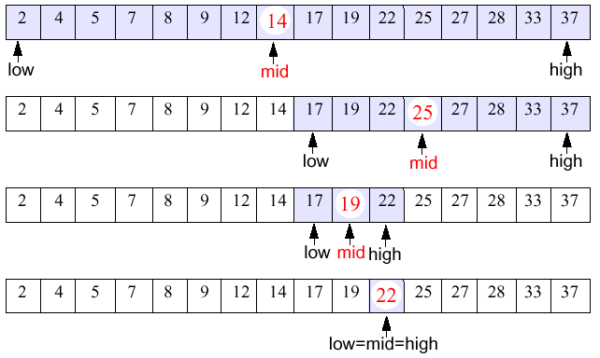
Binary Search
Narrow down the search range in stages
  findElement(22)

Slide 7
Running Time
The range of candidate items to be searched is halved after comparing the key with the middle element
Binary search runs in O(lg n) time (remember recurrence...)
What about insertion and deletion?

Slide 8
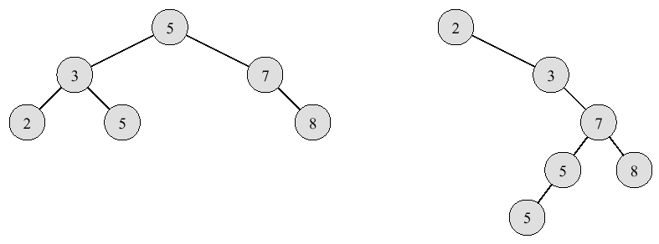
Binary Search Trees
A binary search tree is a binary tree T such that
  each internal node stores an item (k,e) of a dictionary
  keys stored at nodes in the left subtree of v are less than or equal to k
  keys stored at nodes in the right subtree of v are greater than or equal to k
Example sequence 2,3,5,5,7,8

Slide 9
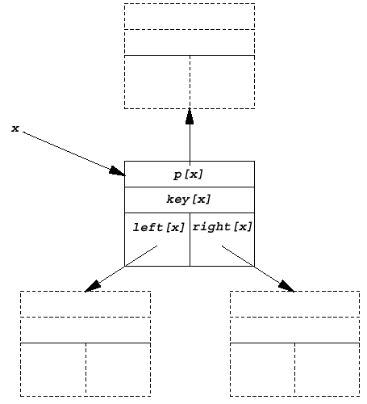
The Node Structure
Each node in the tree contains
  key[x] – key
  left[x] – pointer to left child
  right[x] – pt. to right child
  p[x] – pt. to parent node

Slide 10
Tree Walks
Keys in the BST can be printed using "tree walks"
Keys of each node printed between keys in the left and right subtree – inroder tree traversal
Prints elements in monotonically increasing order
Running time Θ(n)
InorderTreeWalk(x)
01 if x ≠ NIL then
02 InorderTreeWalk(left[x])
03 print key[x]
04 InorderTreeWalk(right[x])

Slide 11
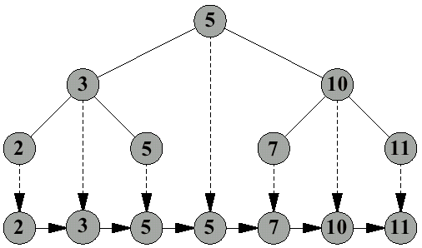
Tree Walks (2)
ITW can be thought of as a projection of the BST nodes onto a one dimensional interval

Slide 12
Tree Walks (3)
A preorder tree walk processes each node before processing its children
A postorder tree walk processes each node after processing its children

Slide 13
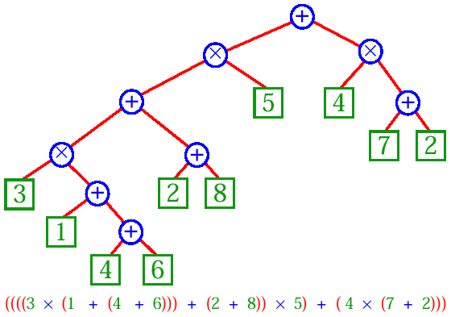
Tree Walks (4)
Printing an arithmetic expression - so called Euler’s walk:
  Print “(“ before traversing the left subtree, traverse it
  Print the value of a node
  Traverse the right subtree, print “)” after traversing it

Slide 14
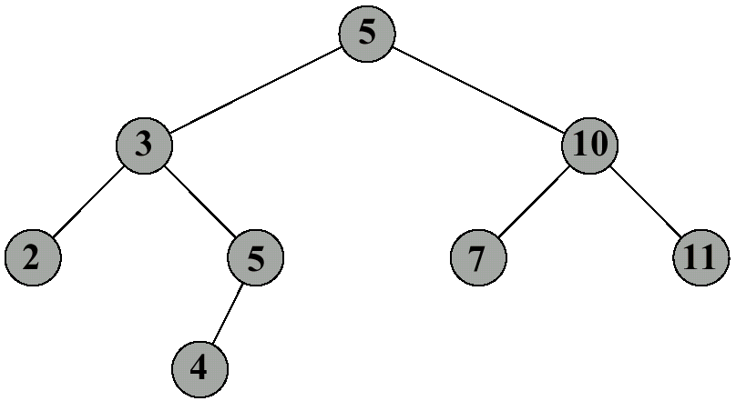
Searching a BST
To find an element with key k in a tree T
  compare k with key[root[T]]
  if k < key[root[T]], search for k in left[root[T]]
  otherwise, search for k in right[root[T]]

Slide 15
Pseudocode for BST Search
Recursive version
Search(T,k)
01 x ← root[T]
02 if x = NIL then return NIL
03 if k = key[x] then return x
04 if k < key[x]
05 then return Search(left[x],k)
06 else return Search(right[x],k)
Iterative version
Search(T,k)
01 x ← root[T]
02 while x ≠ NIL and k ≠ key[x] do
03 if k < key[x]
04 then x ← left[x]
05 else x ← right[x]
06 return x

Slide 16
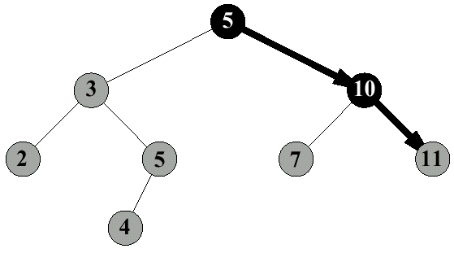
Search Examples
Search(T, 11)

Slide 17
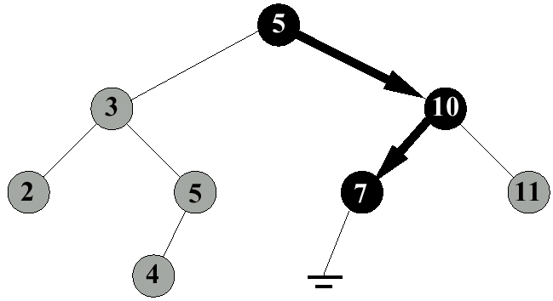
Search Examples (2)
Search(T, 6)

Slide 18
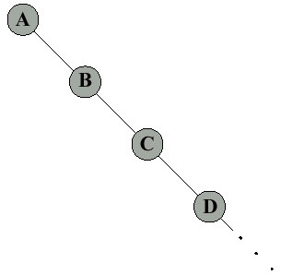
Analysis of Search
Running time on tree of height h is O(h)
After the insertion of n keys, the worst-case running time of searching is O(n)

Slide 19
BST Minimum (Maximum)
Find the minimum key in a tree rooted at x (compare to a solution for heaps)
Running time O(h), i.e., it is proportional to the height of the tree
TreeMinimum(x)
01 while left[x] ≠ NIL
02 do x ← left[x]
03 return x

Slide 20
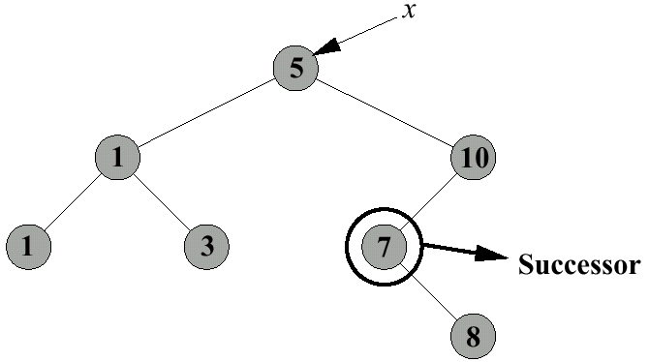
Successor
Given x, find the node with the smallest key greater than key[x]
We can distinguish two cases, depending on the right subtree of x
Case 1
  right subtree of x is nonempty
  successor is leftmost node in the right subtree (Why?)
  this can be done by returning TreeMinimum(right[x])

Slide 21
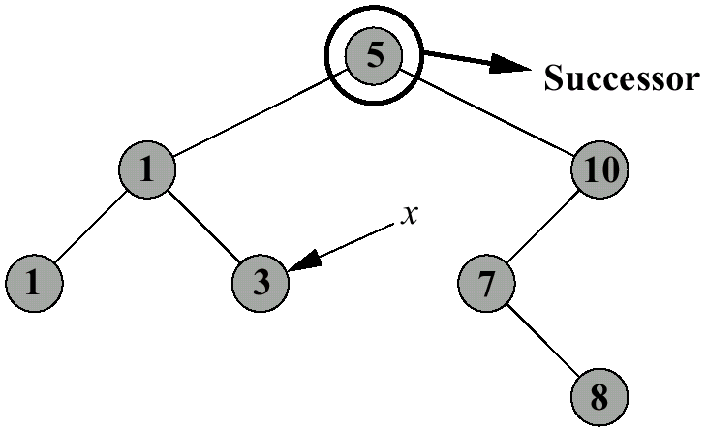
Successor (2)
Case 2
  the right subtree of x is empty
  successor is the lowest ancestor of x whose left child is also an ancestor of x (Why?)

Slide 22
Successor Pseudocode
TreeSuccessor(x)
01 if right[x] ≠ NIL
02 then return TreeMinimum(right[x])
03 y ← p[x]
04 while y ≠ NIL and x = right[y]
05 x ← y
06 y ← p[y]
03 return y
For a tree of height h, the running time is O(h)

Slide 23
BST Insertion
The basic idea is similar to searching
  take an element z (whose left and right children are NIL) and insert it into T
  find place in T where z belongs (as if searching for z),
  and add z there
The running on a tree of height h is O(h), i.e., it is proportional to the height of the tree

Slide 24
BST Insertion Pseudo Code
TreeInsert(T,z)
01 y ← NIL
02 x ← root[T]
03 while x ≠ NIL
04 y ← x
05 if key[z] < key[x]
06 then x ← left[x]
07 else x ← right[x]
08 p[z] ← y
09 if y = NIL
10 then root[T] ← z
11 else if key[z] < key[y]
12 then left[y] ← z
13 else right[y] ← z

Slide 25
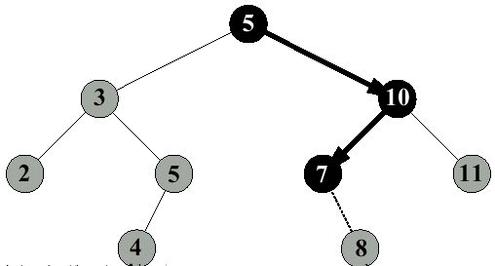
BST Insertion Example
Insert 8

Slide 26
BST Insertion: Worst Case
In what kind of sequence should the insertions be made to produce a BST of height n?

Slide 27
BST Sorting
Use TreeInsert and InorderTreeWalk to sort a list of n elements, A
TreeSort(A)
01 root[T] ← NIL
02 for i ← 1 to n
03 TreeInsert(T,A[i])
04 InorderTreeWalk(root[T])

Slide 28
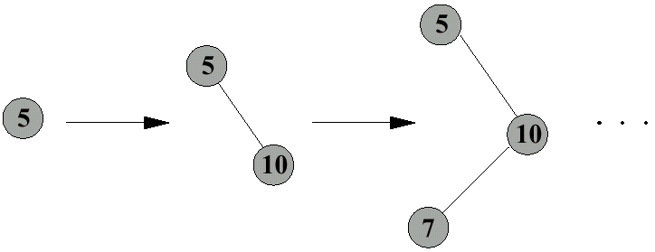
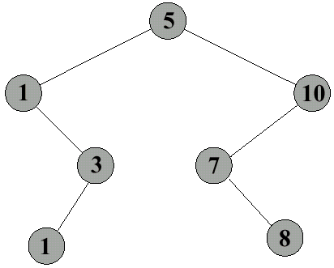
BST Sorting (2)
Sort the following numbers
5 10 7 1 3 1 8
Build a binary search tree
Call InorderTreeWalk
1 1 3 5 7 8 10

Slide 29
Deletion
Delete node x from a tree T
We can distinguish three cases
  x has no children
  x has one child
  x has two children

Slide 30
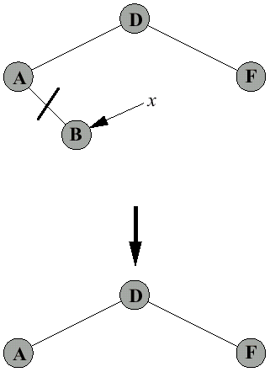
Deletion Case 1
If x has no children – just remove x

Slide 31
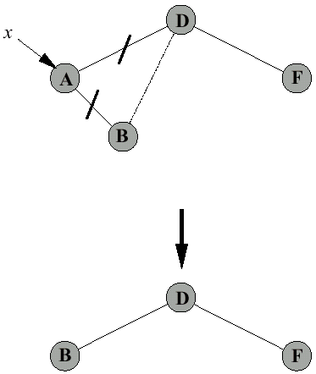
Deletion Case 2
If x has exactly one child, then to delete x, simply make p[x] point to that child

Slide 32
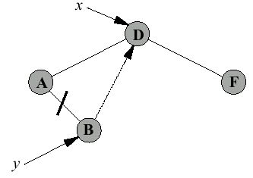
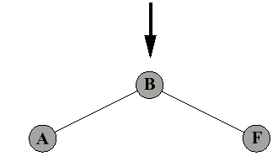
Deletion Case 3
If x has two children, then to delete it we have to
  find its successor (or predecessor) y
  remove y (note that y has at most one child – why?)
  replace x with y

Slide 33
Delete Pseudocode
TreeDelete(T,z)
01 if left[z] = NIL or right[z] = NIL
02 then y ← z
03 else y ← TreeSuccessor(z)
04 if left[y] ≠ NIL
05 then x ← left[y]
06 else x ← right[y]
07 if x ≠ NIL
08 then p[x] ← p[y]
09 if p[y] = NIL
10 then root[T] ← x
11 else if y = left[p[y]]
12 then left[p[y]] ← x
13 else right[p[y]] ← x
14 if y ≠ z
15 then key[z] ← key[y] //copy all fileds of y
16 return y

Slide 34
Balanced Search Trees
Problem: worst-case execution time for dynamic set operations is Θ(n)
Solution: balanced search trees guarantee small height!

Slide 35
Next Week
Balanced Binary Search Trees:
  Red-Black Trees

